Slide 1

JUMPCLOUD
Nicholas Catani
ISM-6331
Information Systems Security

Slide 2
Content Layout
Quick Introduction
Features
Identity
Devices
Access
Cost Analysis
Pricing Breakdown
Competitors
Installation
Recommendations
Demo Illustration
Page 2

Slide 3
Quick Introduction
JumpCloud’s open directory platform makes it possible to unify your technology stack across identity, access, and device management, in a cost-effective manner that doesn’t sacrifice security or functionality.
Page 3

Slide 4
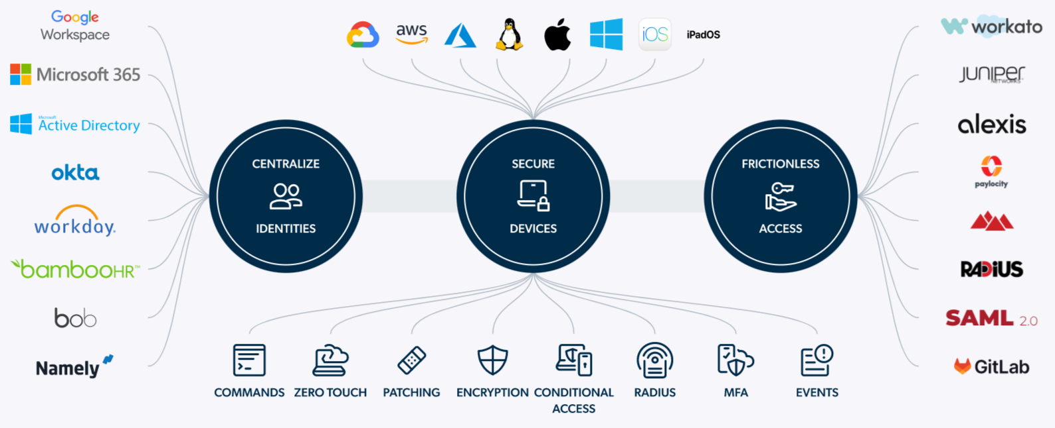
Features
Page 4

Slide 5
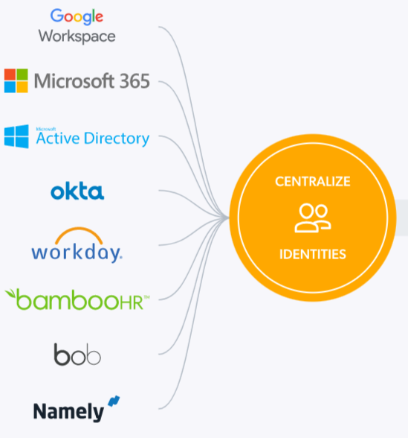
Identity
Unify identities with open integration capabilities
Protect identities with built-in multi-factor authentication
Secure credentials with the native password manager
Page 5

Slide 6
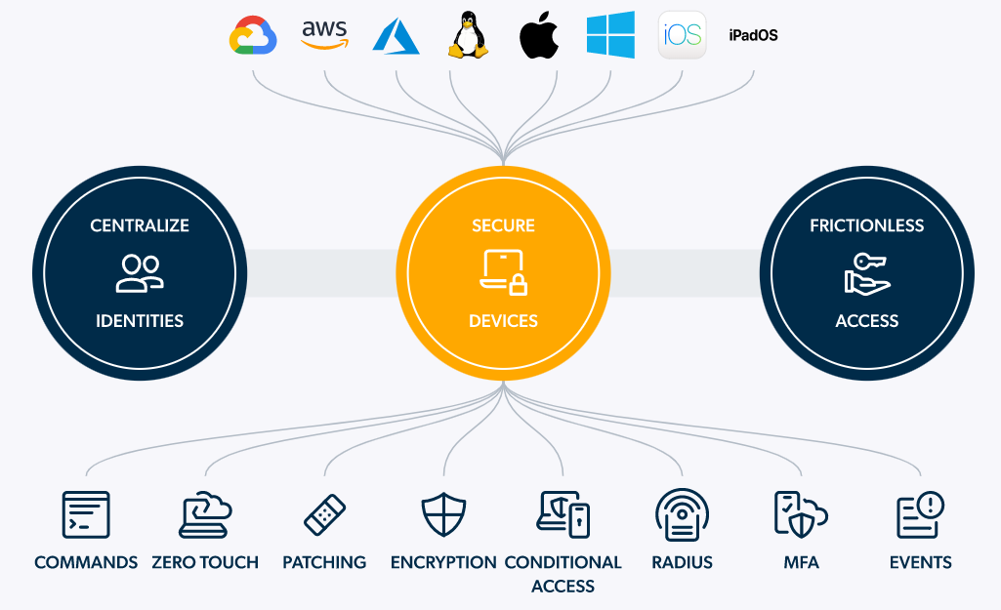
Devices
Manage all endpoints in one platform
Secure all devices that access company resources
Enforce policies and patch systems remotely
Page 6

Slide 7
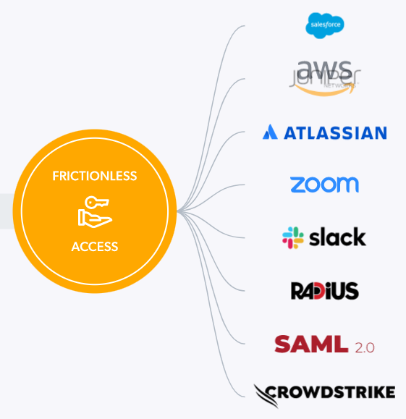
Access
Group-based access and privilege control
Full-scale access monitoring and event logging
End-to-end lifecycle management for all users
Page 7

Slide 8
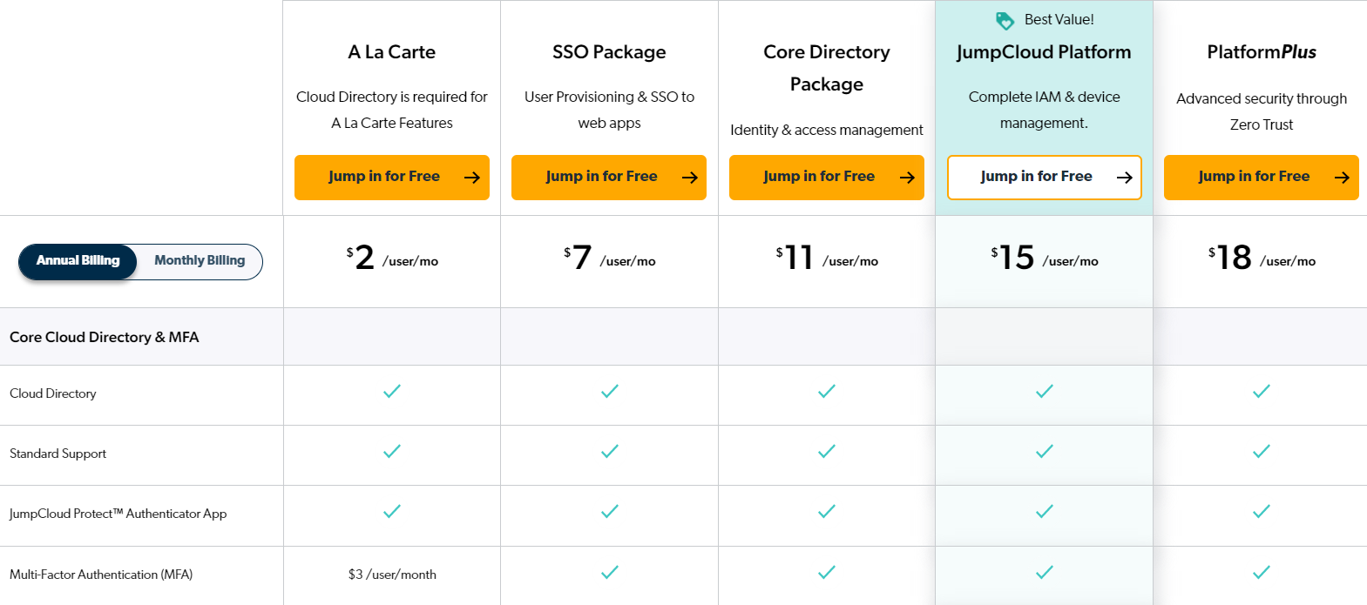
Cost Analysis
Page 8

Slide 9

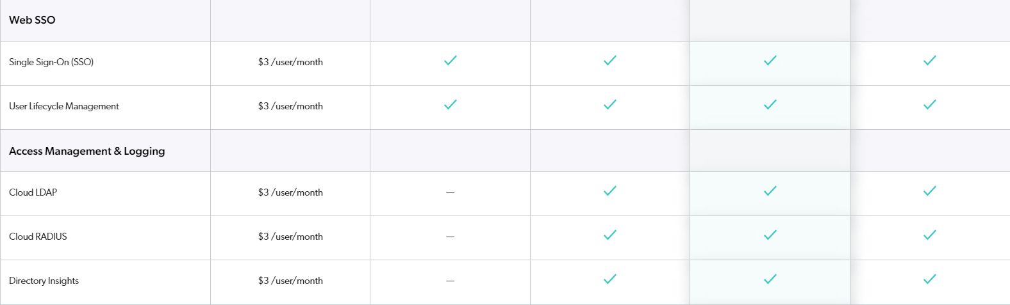
Page 9

Slide 10
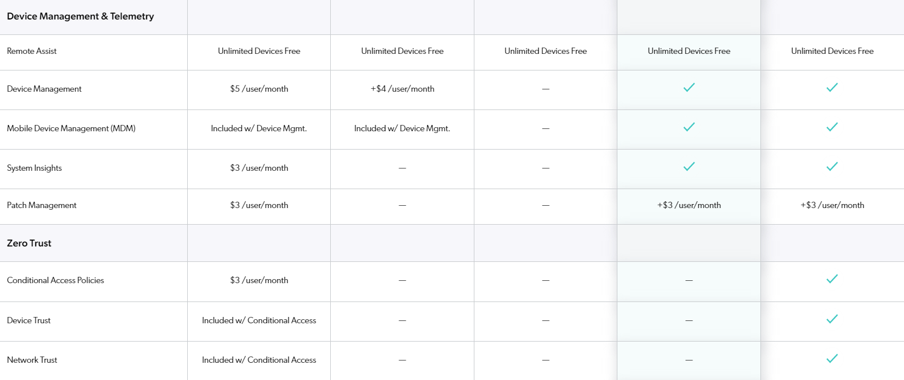
Page 10

Slide 11
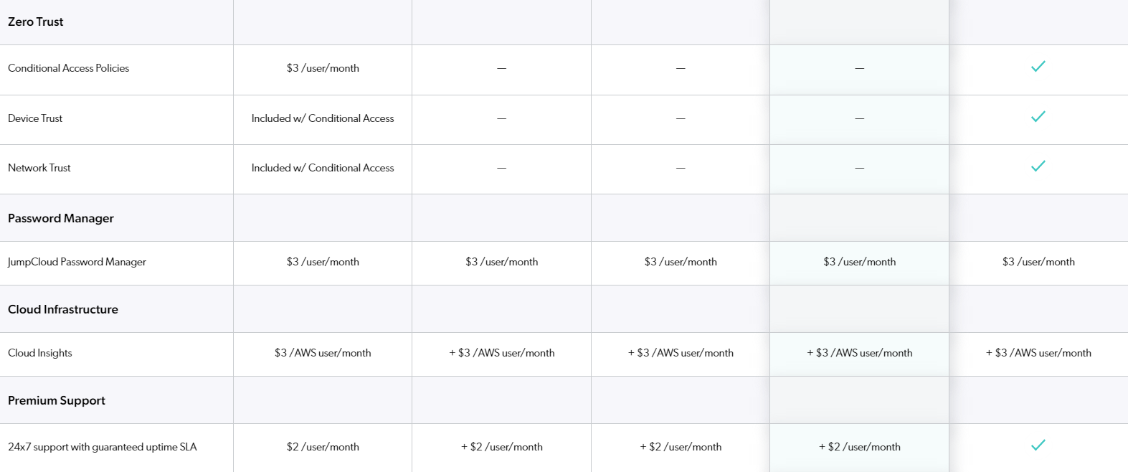
Page 11

Slide 12
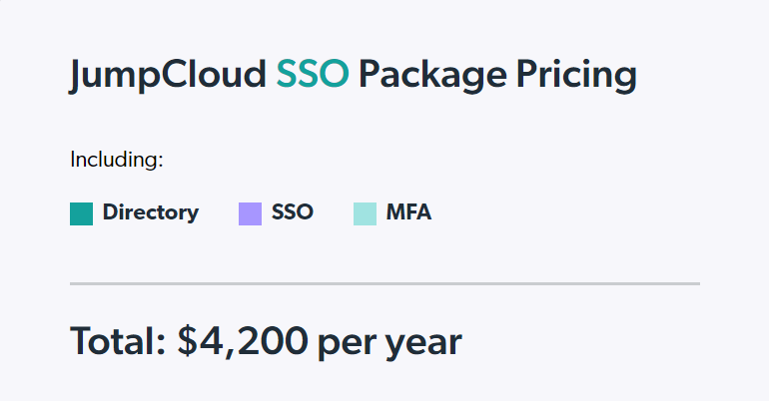
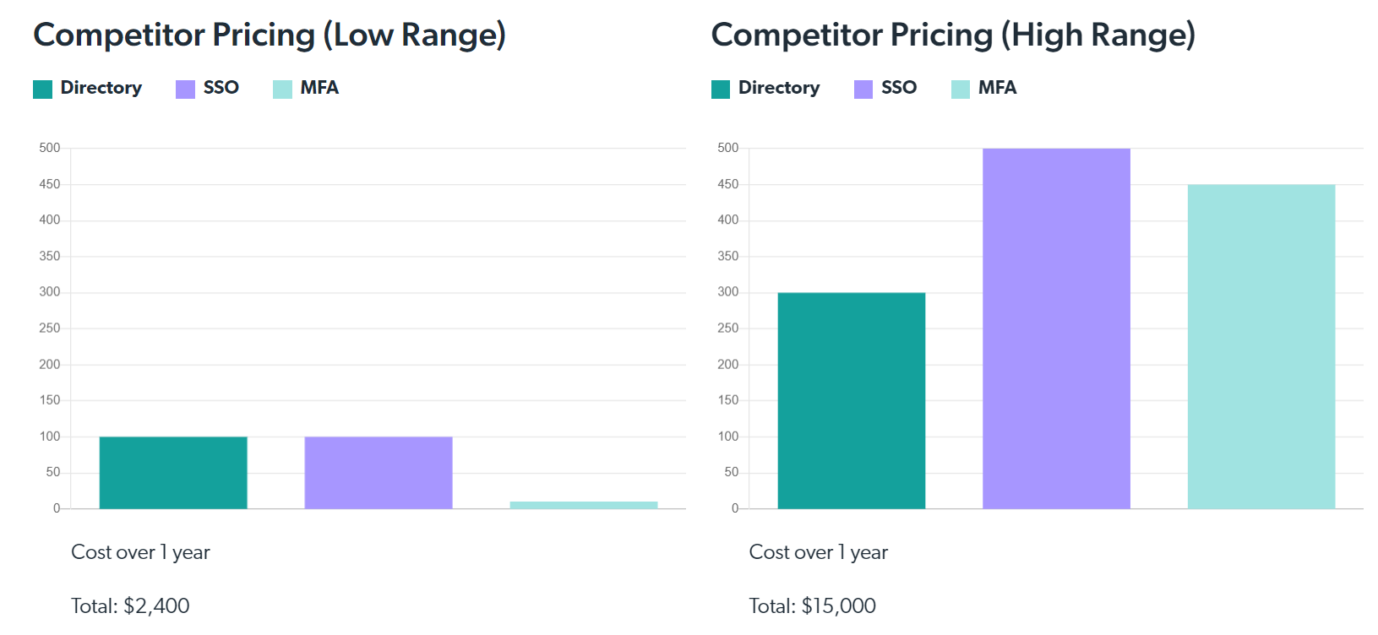
Pricing Breakdown
Used working environment for 50 users to predict annual costs
$500
$450
$300
$100
$100
$0
Page 12

Slide 13




Competitors
Azure Active Directory
SERVICE
Single Sign-On
Cloud Platform
SecureID Access
STRENGTH
Intuitive to set up & customizable
Speed & Extensibility using PowerShell
Community support & assistance
For all type of users
Threat for JumpCloud
WEAKNESS
Tedious maintenance in case of lost MDs
Overly complicated to use
Downtime while running upgrades
Tough to implement & difficult to install
Opportunity for JumpCloud
Page 13

Slide 14
Installation
Settings
Create global password, aging, complexity, lockout.
Building Users
Creation of the user directory.
Deploying Agents to Devices
Install JumpCloud agent on devices connected to the domain.
Going Live
Creating Groups
User group access deployment
Activation
Policies
Enforce security standards
For an exhaustive adoption process, follow the link below.
JumpCloud Admin Implementation Guide
Page 14

Slide 15
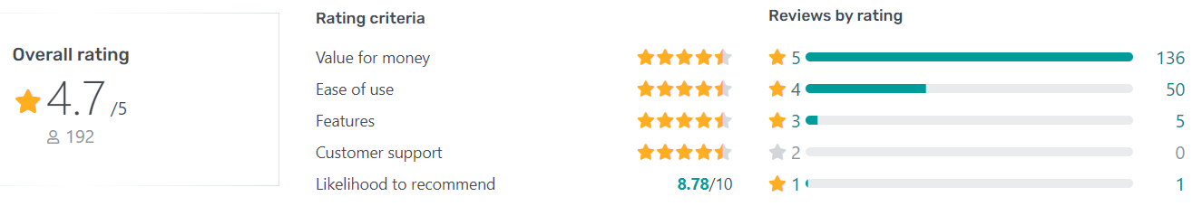
Recommendations
Check if directory’s functionalities match organization needs.
If adopted, extensive training is required – Unexperienced customer support.
Company’s IS should use Microsoft for a greater policy configuration.
Page 15

Slide 16
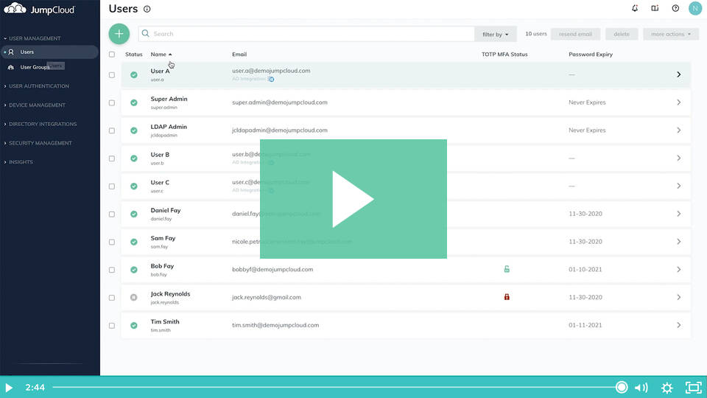
Demo Illustration
JumpCloud Demo - JumpCloud
Page 16

